Slide 1

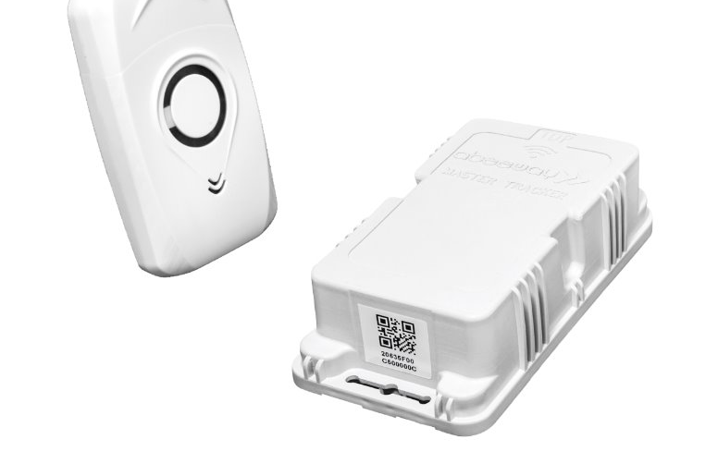

HYBRID TIMER PLUG WITH MANUAL AND MOBILE APP CONTROL
230013A – Abeywarna D.H.
230100M – Chandrakumara H.A.D.C.
230229P – Hansindu M.M.A.D.
230697V – Weerasinghe J.H.R.

Slide 2
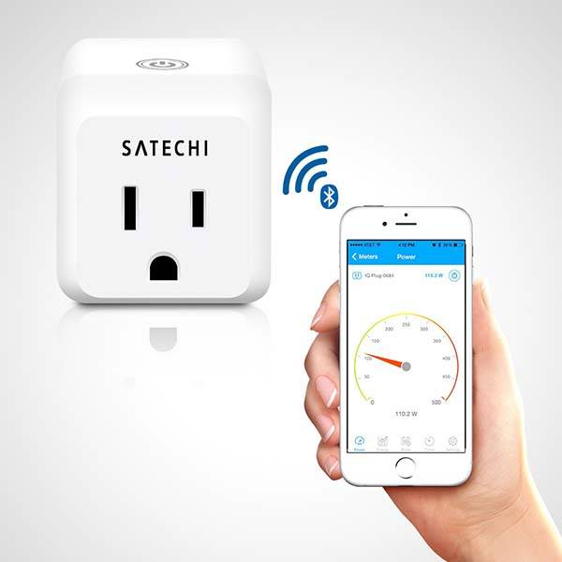
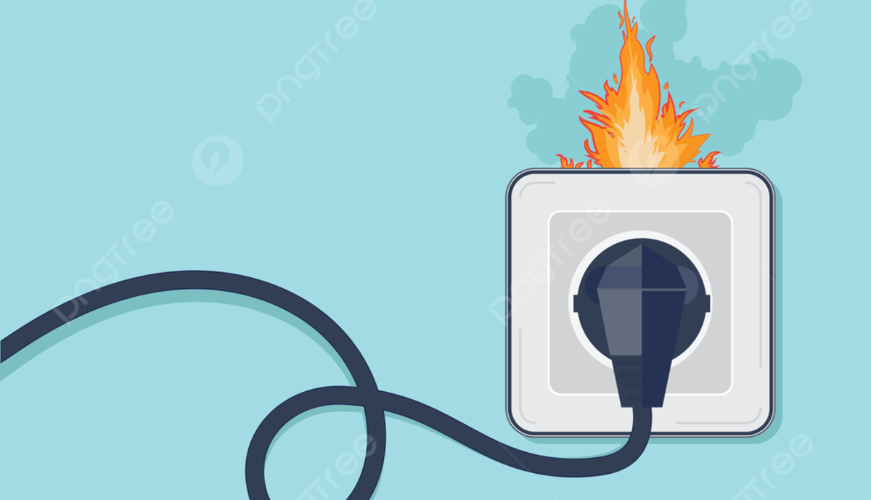
PROBLEM STATEMENT:
Keeping appliances plugged in for too long can have various side effects.
Users often forget to turn off appliances, leading to energy waste or hazards or reduction in lifetimes.​​
Limited flexibility in scheduling and unable to control remotely.​

Slide 3
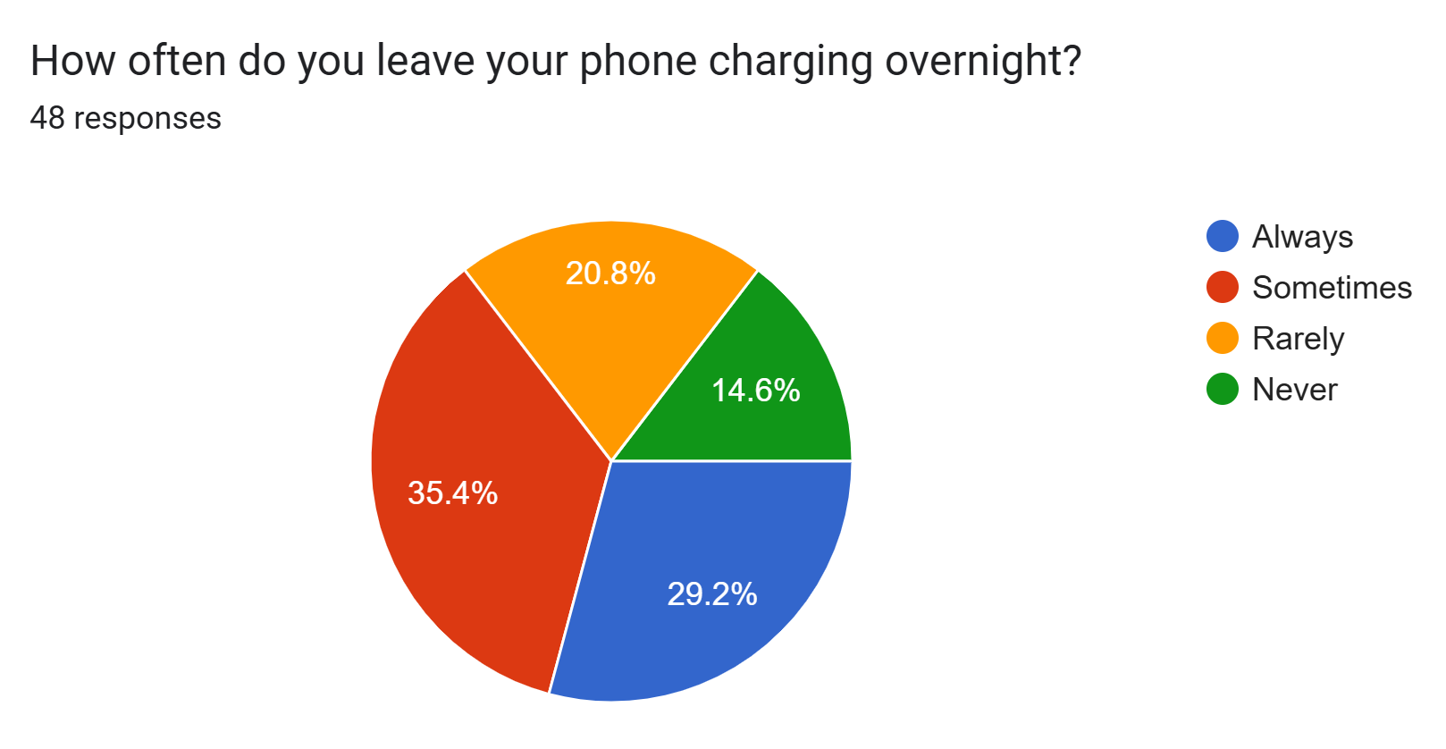
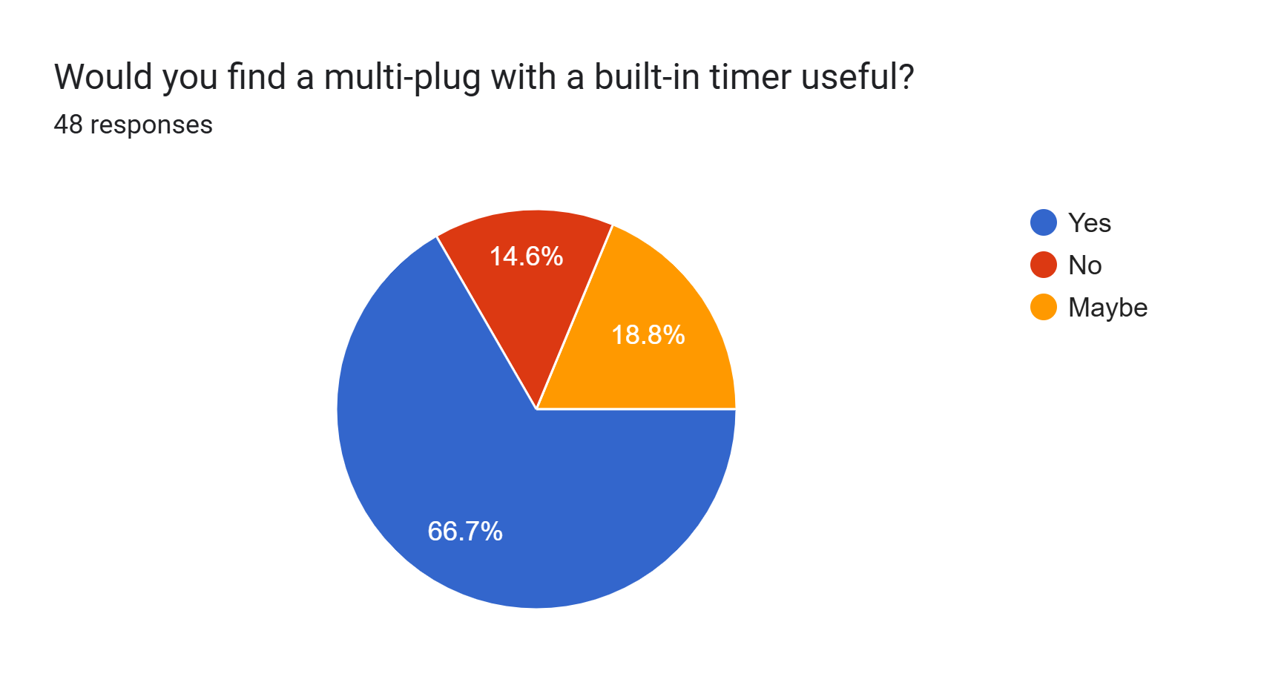
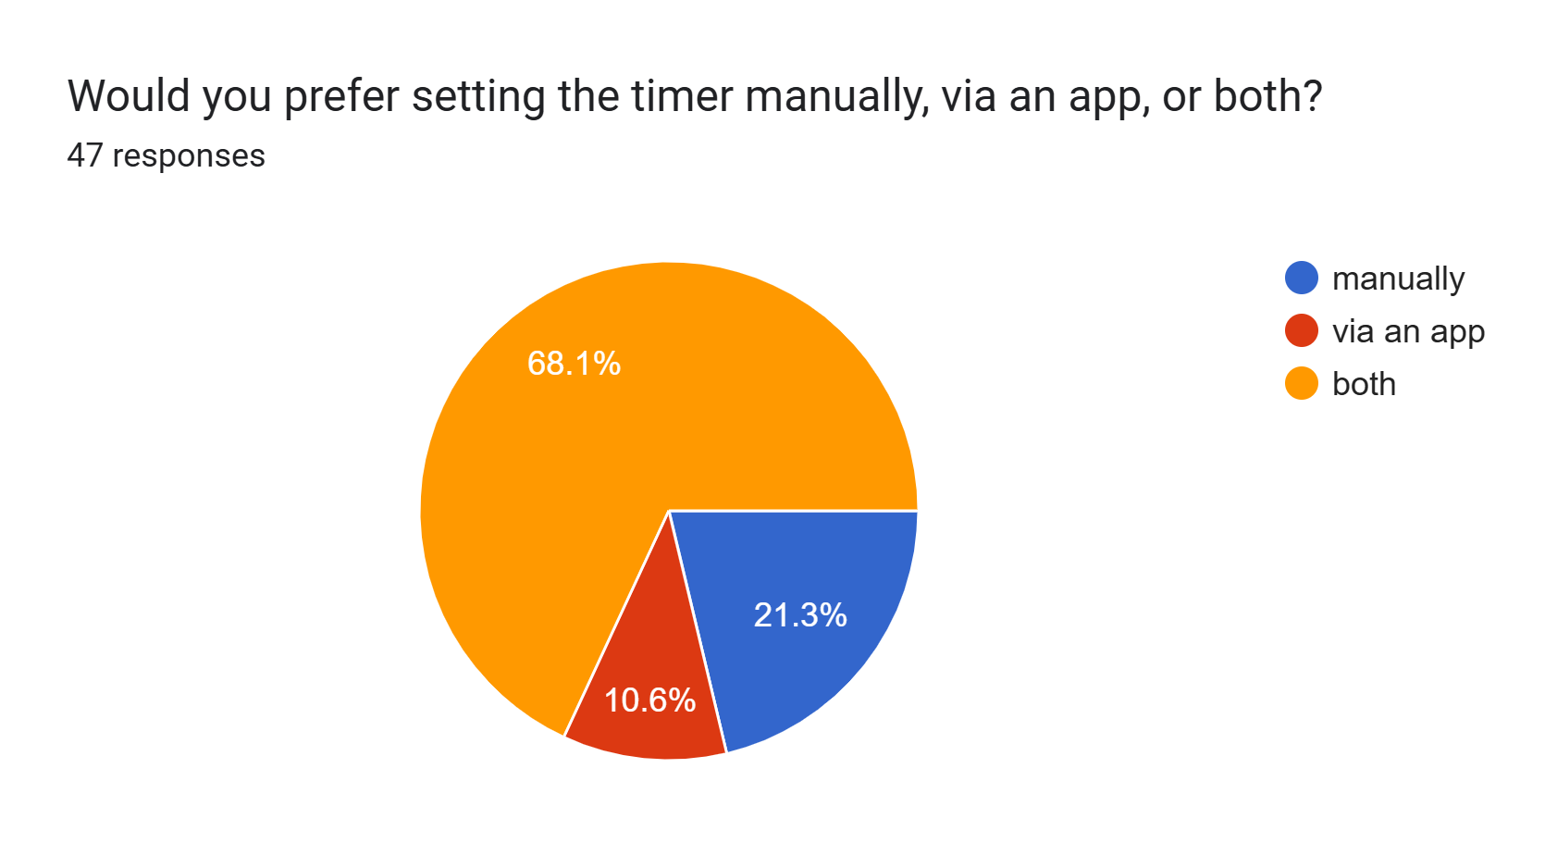
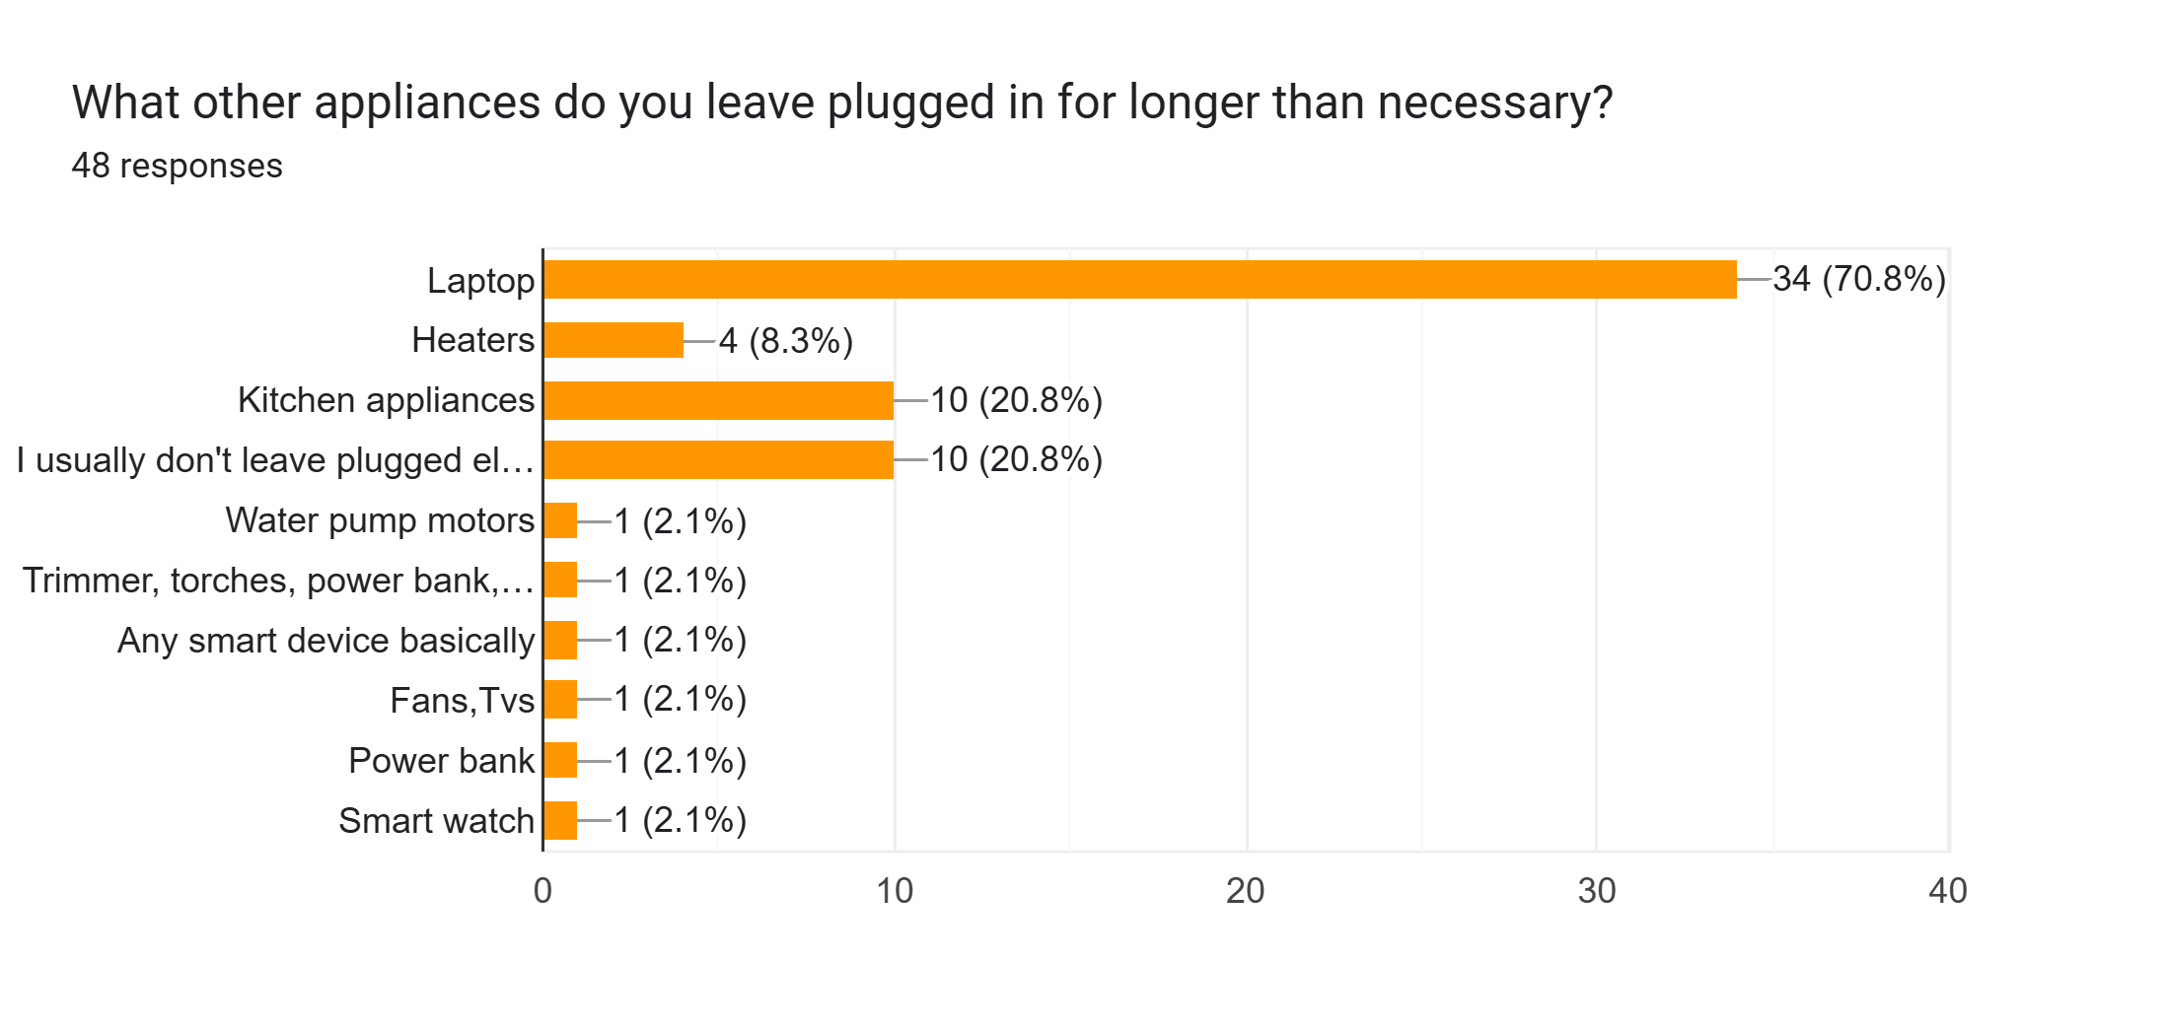
PROBLEM VALIDATION:

Slide 4

SOLUTION ARCHITECTURE:
CORE COMPONENTS:
ESP32 microcontroller (Wi-Fi )
Relay module to control AC appliances
Manual control via onboard dial
Mobile app (custom app)

Slide 5
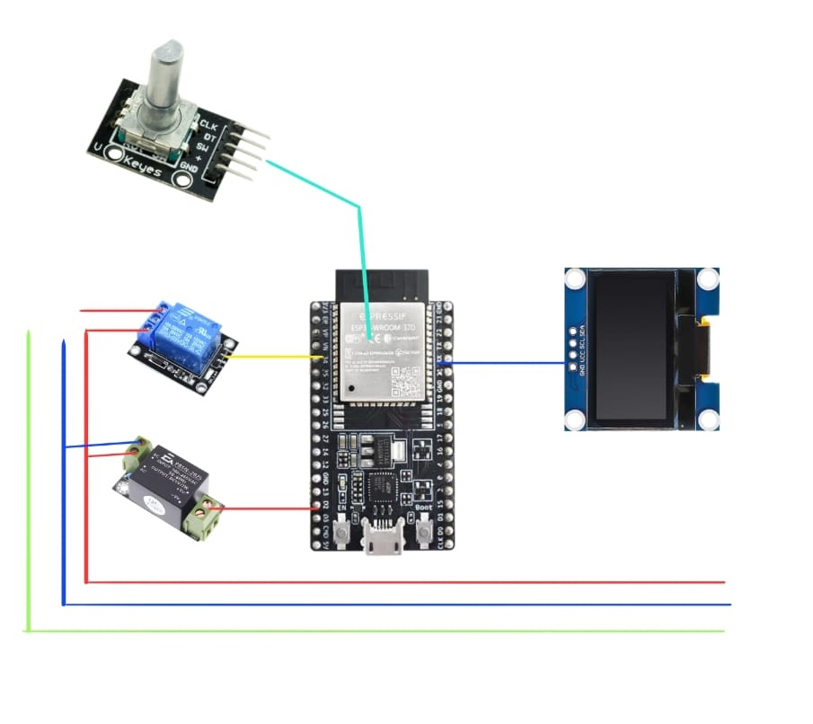
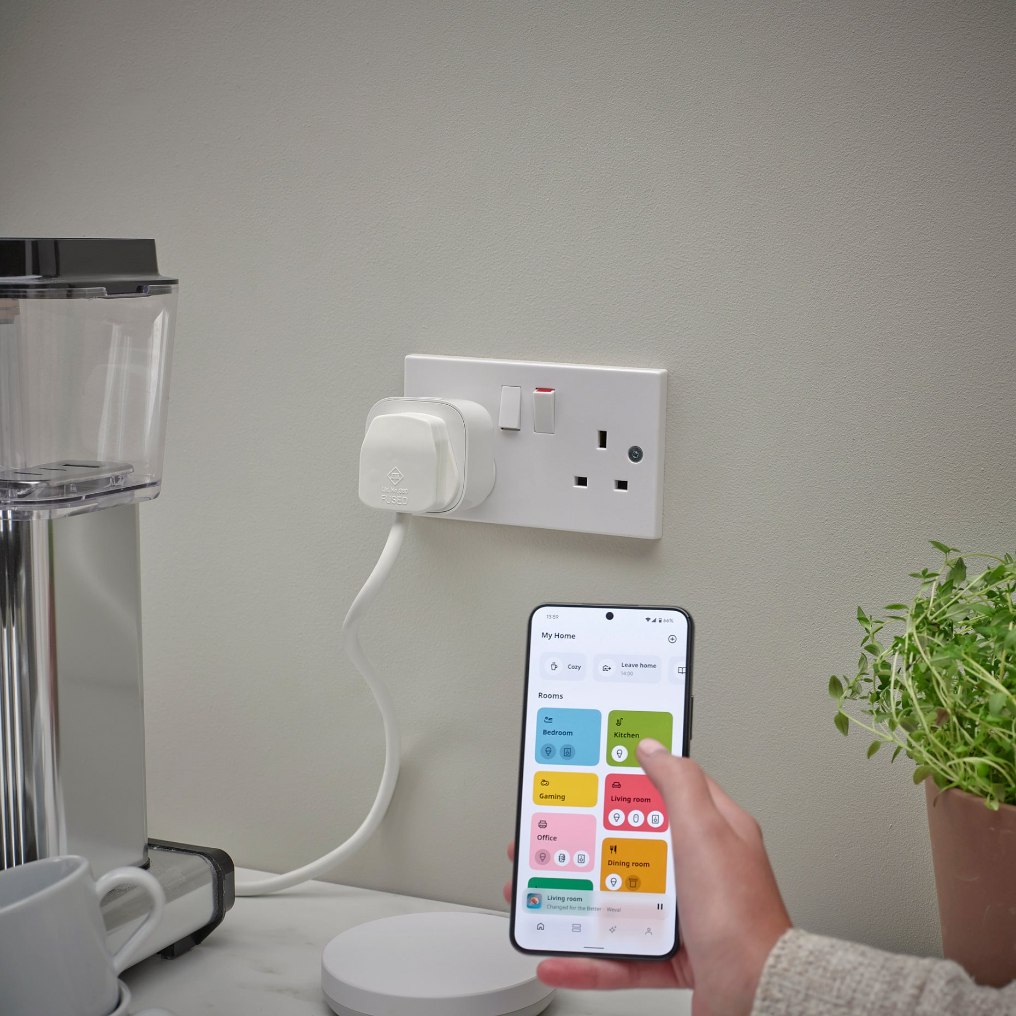
SOLUTION ARCHITECTURE ABSTRACTION
Rotary Encoder
OLED Display
Relay Module
Device
ESP32 Microcontroller
Main Power
AC to DC Converter

Slide 6
ALTERNATIVES CONSIDERED:
Detecting trickle charging and turning off chargers when low current is drawn.
However, this behavior only applies to a limited range of devices and specific charging patterns. Therefore, we decided to create a solution that is applicable to a wider variety of devices.
That being said, we hope to integrate this feature into our product in a future version.

Slide 7
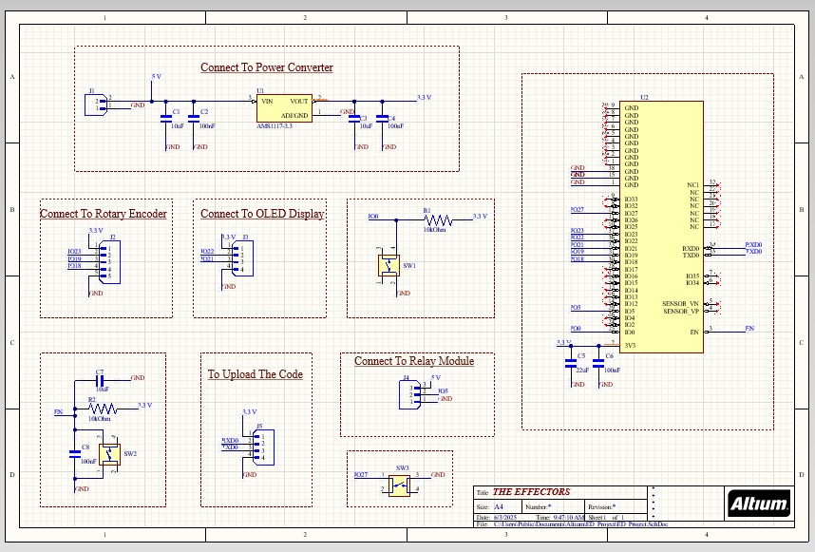
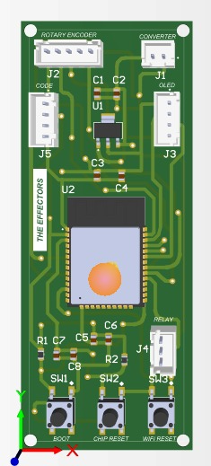
PCB DESIGN & SCHEMETIC

Slide 8
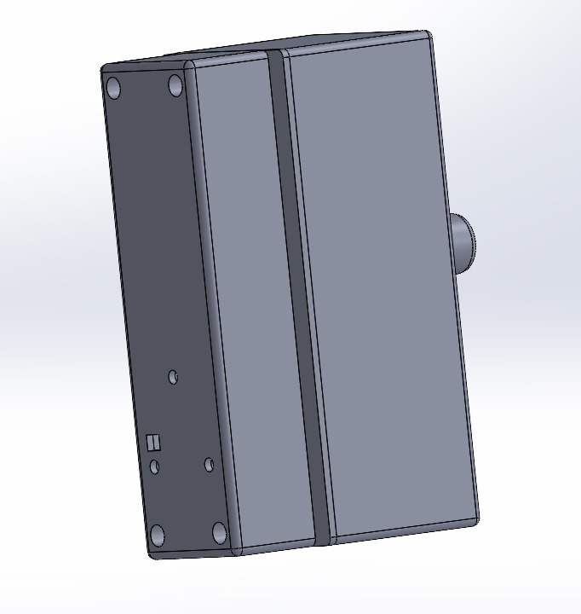
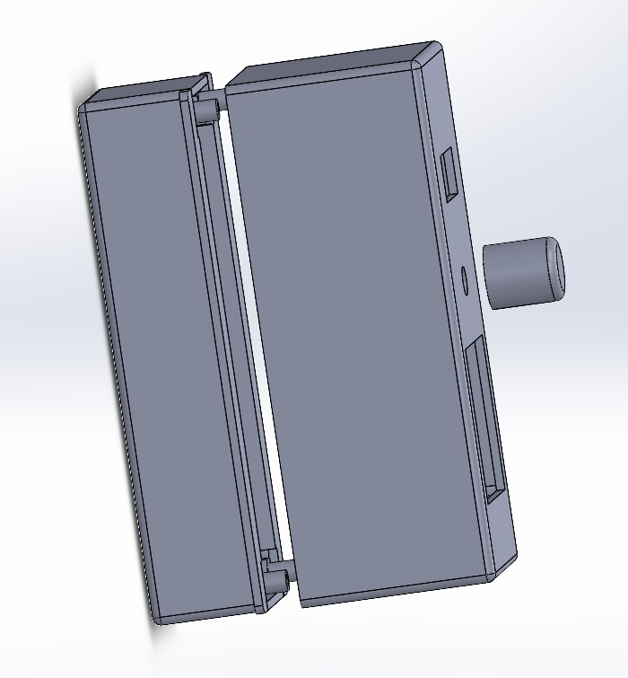
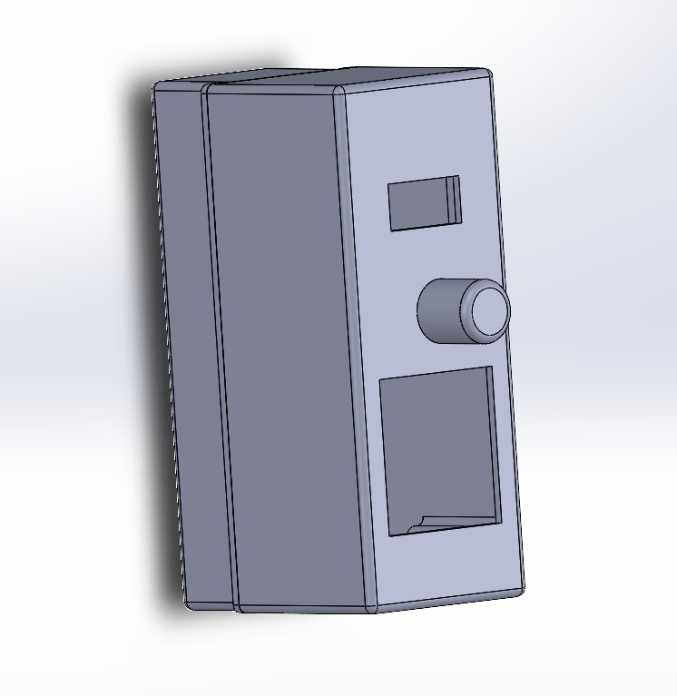
ENCLOSURE DESIGN:

Slide 9
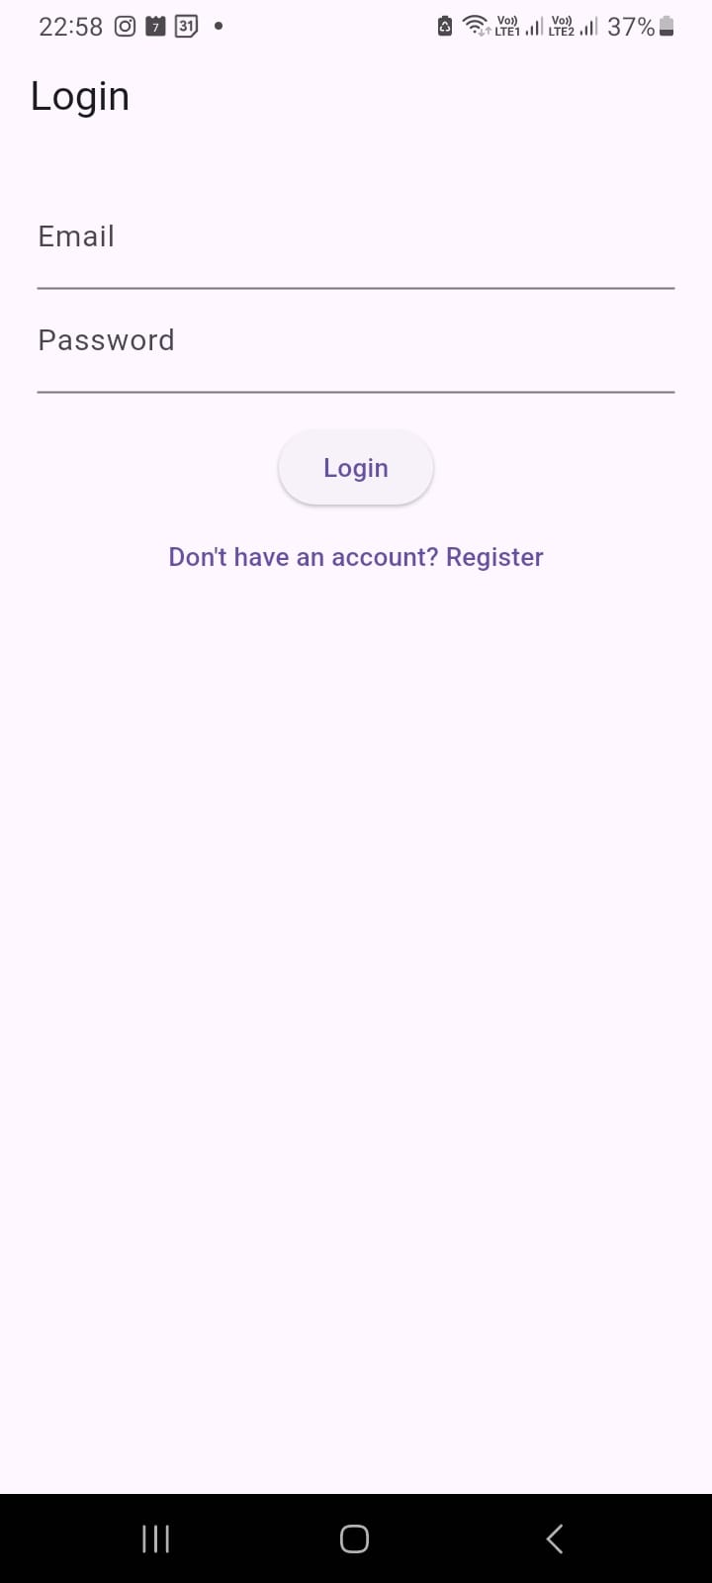
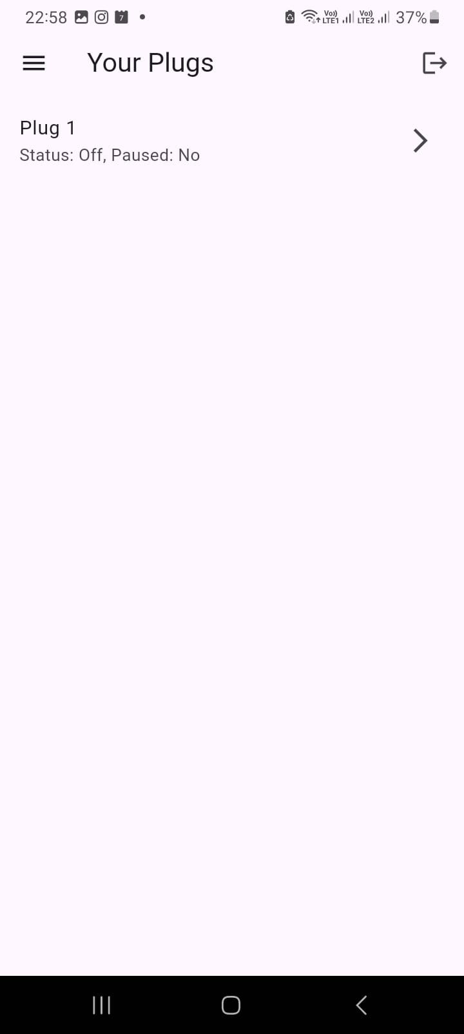
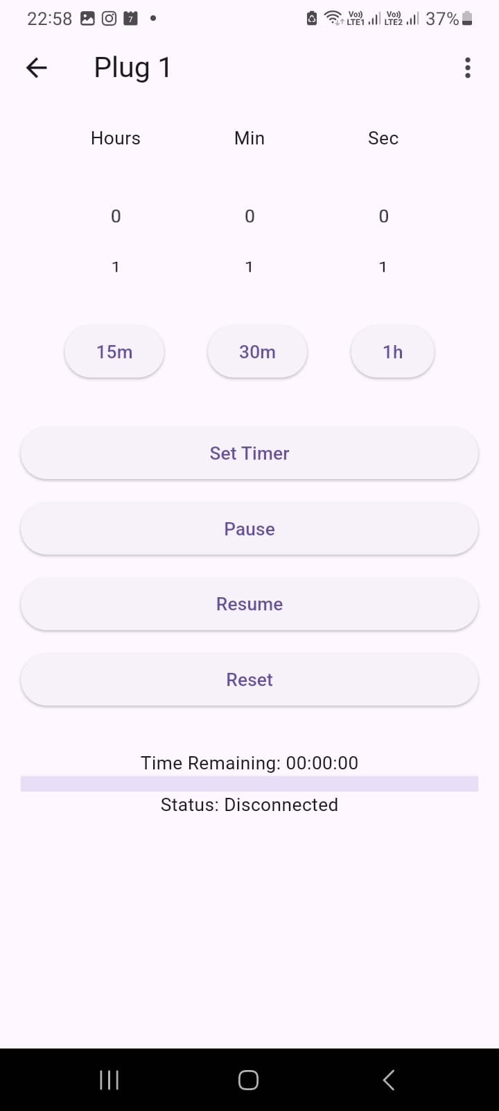
USER INTERFACE:

Slide 10
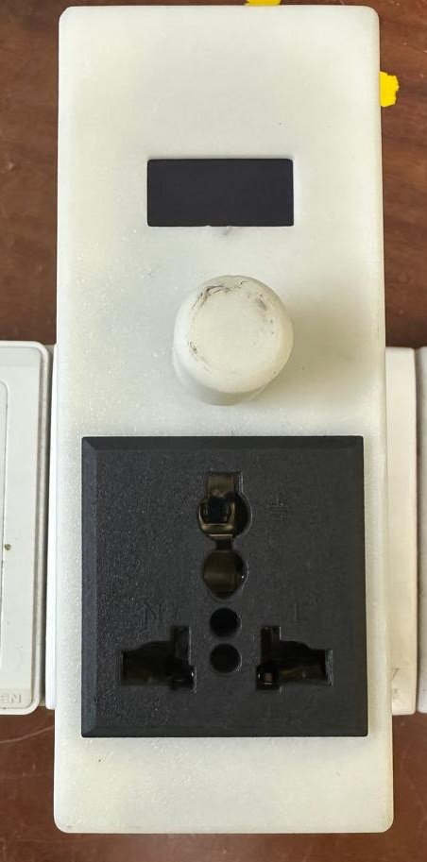
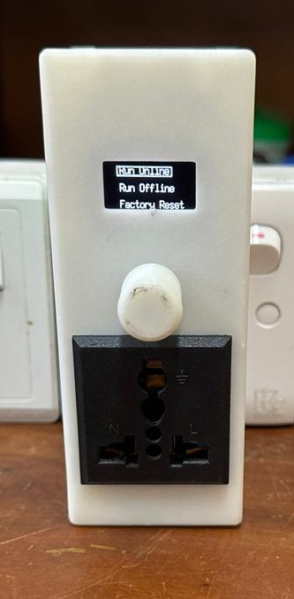
FINAL PRODUCT

Slide 11
CHALLENGES & SOLUTIONS:
How to Connect ESP32 to Mobile App.
Reducing the Product Dimensions.
Market Alternatives.
Output of the ESP32 was not sufficient to control the relay module.
To find the SMD components.

Slide 12
THANK YOU.

